Slide 1

Forecasting Stock Prices In A Post-Covid Market
ISYE 603: Final Project Presentation
Advised By: Professor Shiyu Zhou
Nandu Venu, Emma Hansen, Bo Zhou, Sirin Abraham
Notes:
Hi everyone! We are the TYRI team
and Our project is to optimize a QR..cell (for TYRI Americas).
I'm Jiayao. And here are my teammates: Sirin, Ai, Thomas, Aravind

Slide 2




Meet the Team
Sirin Abraham
Nandu Venu
Emma Hansen
Bo Zhou

Slide 3

Agenda
Project Motivation
Project Goal
Data Pre-Processing
Forecasting Analysis
R Shiny App

Slide 4
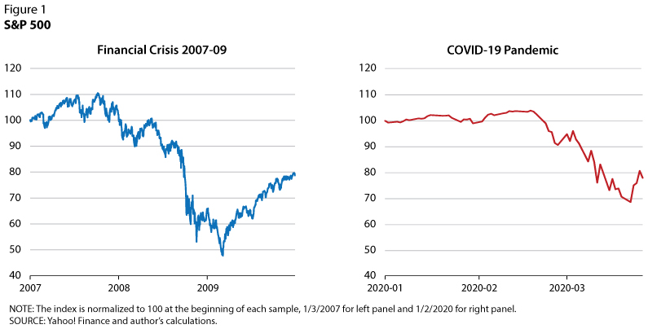
Project Motivation
COVID-19 had a drastic impact on numerous sectors of the market.
Organizations had to adjust their strategy depending on their respective markets.
Predicting stock prices over a medium to large time-horizon was difficult due to the impact of the pandemic.

Slide 5
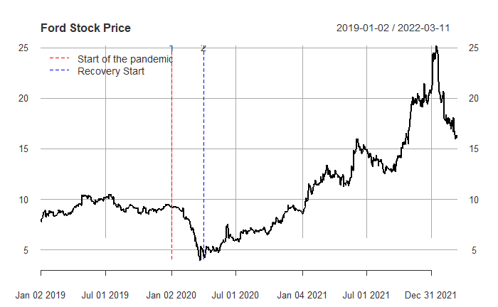
Effect of pandemic on Ford stock price

Slide 6

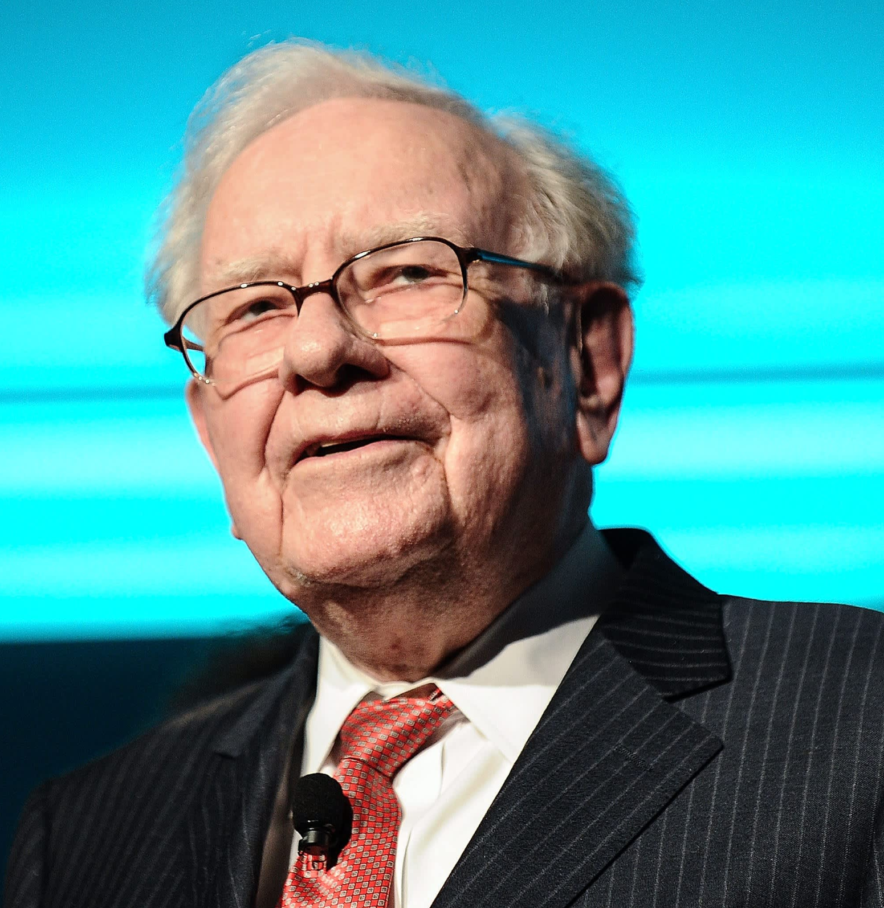

Traditional Investing
Day Trading

Slide 7
Project Goal
Select four organizations from different segments of industry.
Build reliable forecasting models to accurately predict stock prices for each organization.
Build an R-Shiny Application to provide real-time forecasts for the next trading period.

Slide 8




Selected Stocks

Slide 9
Data Collection and Pre-processing
Data was collected through the Yahoo Finance API
Raw data was converted to XTS objects to ensure uniform handling of non-continuous temporal data
The data contained following variables, Date, Opening Price, Closing Price, High, Low, Volume.
Used Closing Price for building the model
Each selected stock fell almost by 50% when pandemic hit and started recovering few months after.
Based on the observations, we chose post-covid recovery data to ensure we produce a reliable model

Slide 10
Forecasting Models
Forecasting methods explored for each stock are:
Naïve
Regression
Rolling Arima
Simple Neural Networks
Deep Learning Models
Training and Testing sets were selected to minimize the noise in the data. For example,
Model Used | Training Period | Testing Period | MAPE
Regression Model – Trend AMZ Stock | (01-01-22) - (02-28-22) | (03-01-22) - (03-12-22) | 3.11
 | (01-01-21) - (02-28-22) | (03-01-22) - (03-12-22) | 15.57
 | (01-01-20) - (02-28-22) | (03-01-22) - (03-12-22) | 27.844

Slide 11
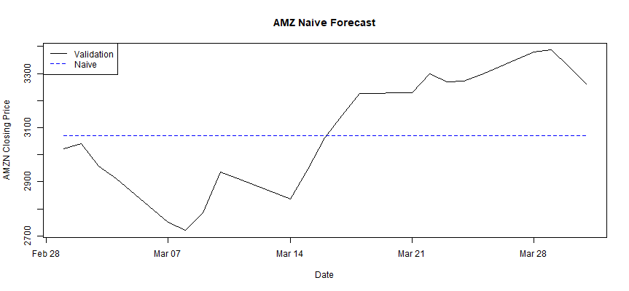
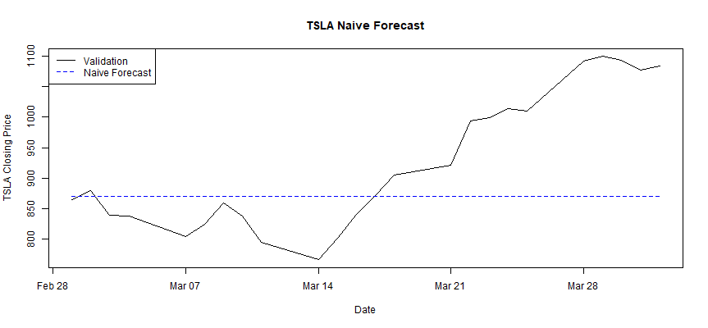
Naïve Method
Naïve does produce reasonable forecasts for a small testing period such as a week.
However, it cannot account for the internal fluctuation in stock prices caused by daily buying/selling.
Better models to account for this fluctuation and short-term trends needed to be found.
 | Google | Tesla | Ford | Amazon
MAPE | 3.12 | 9.00 | 4.04 | 6.00

Slide 12
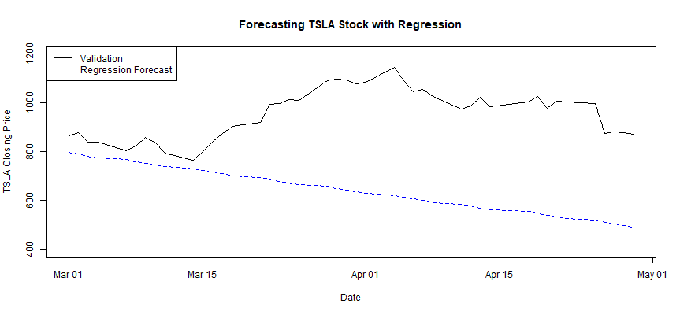
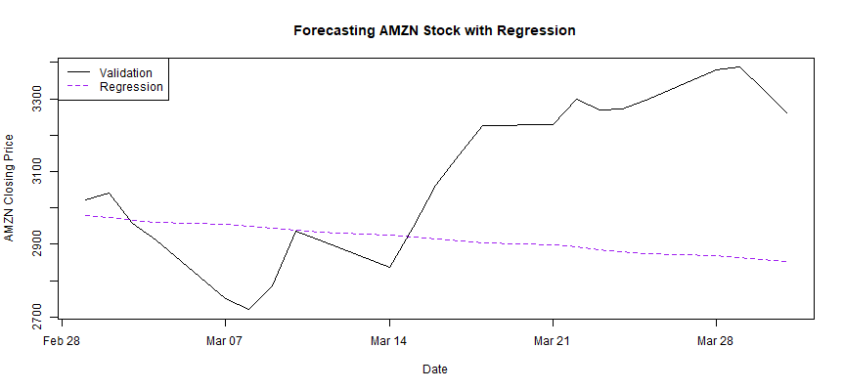
Regression
Regression models with linear trends were fitted for each stock.
The Regression model captures short term trend but does not account for volume of stocks exchanged.
The prediction accuracy was not found to be better than the naïve method.
 | Google | Tesla | Ford | Amazon
MAPE | 21.54 | 11.13 | 16.88 | 7.61

Slide 13
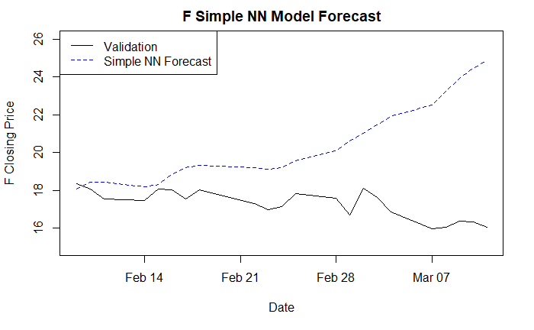
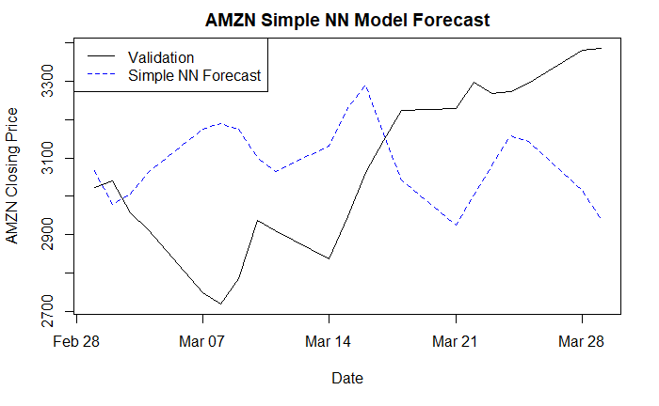
Simple Neural Networks
The NN model was found to capture short-term trend and daily buying/selling activity relatively well.
It may be used for short to medium term forecasts
 | Google | Tesla | Ford | Amazon
MAPE | 6.65 | 14.12 | 19.20 | 8.65

Slide 14
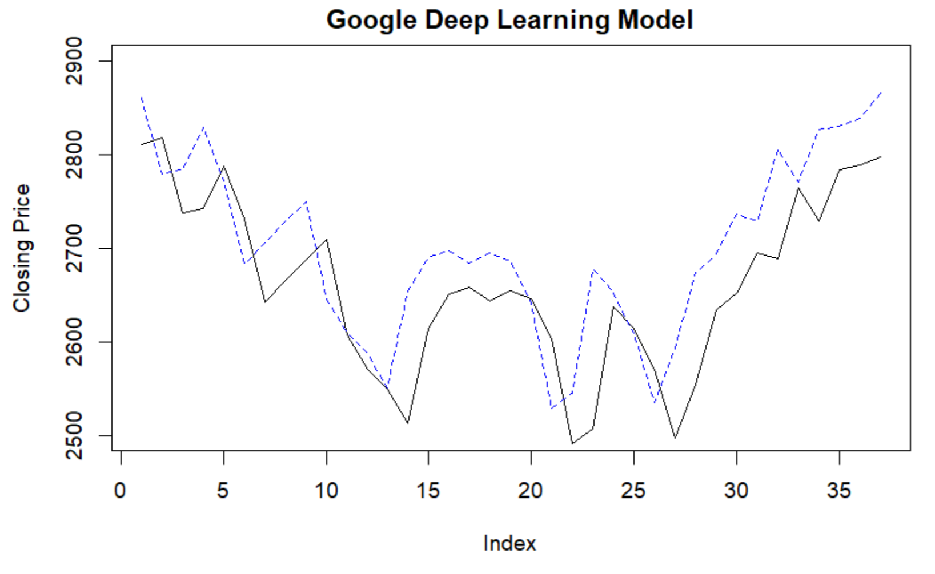
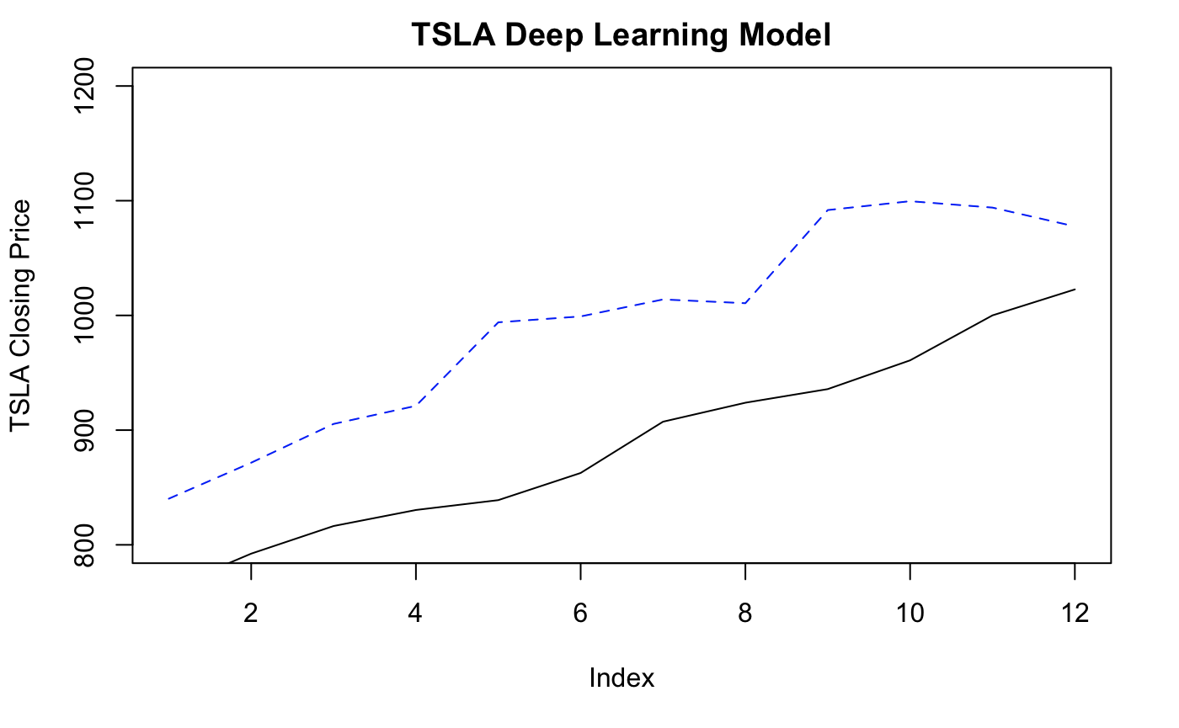
Deep Learning Models
A DL model with four hidden layers, each with 16-32 nodes was fitted to data for each stock.
The deep learning model captured short term trend and daily volume very well for Ford and Google.
Risk of overfitting depends on training data as observed for the Amazon Stock Data.
 | Google | Tesla | Ford | Amazon
MAPE | 2.71 | 11.13 | 5.55 | 129.93

Slide 15
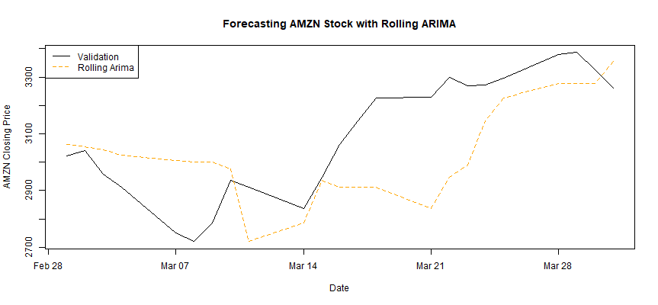
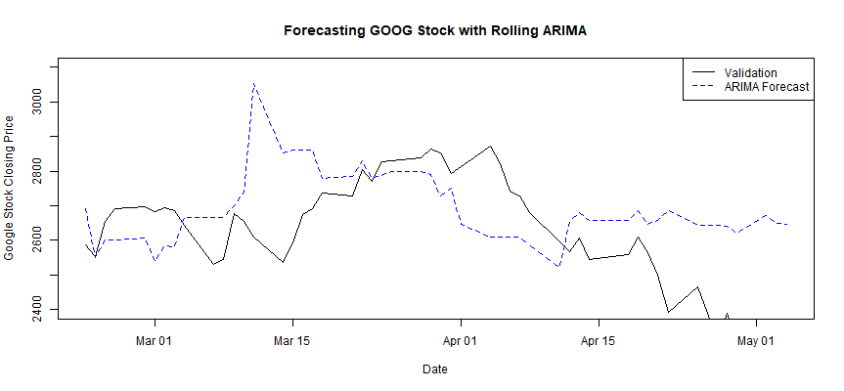
Rolling Arima
Rolling Arima Model was fitted for each selected stock.
Training window was fixed at two weeks and the window moves forward with each forecast.
The prediction accuracy was found to be much better than the naïve method for short-medium term forecasts
 | Google | Tesla | Ford | Amazon
MAPE | 3.48 | 8.44 | 4.07 | 5.32

Slide 16
R Shiny App for Real-Time Forecasting
App Link : https://sirinabraham.shinyapps.io/Stock_Price_Predictor/
Yahoo Finance: https://finance.yahoo.com/

Slide 17
Summary of Results
The best model for Amazon was Rolling Arima
The best model for Tesla was Rolling Arima
The best model for Google was Deep Learning
The best model for Ford was Naïve however Rolling ARIMA and Deep Learning had low MAPE value(~5%)
​Model | Google​ | Tesla​ | Ford​ | Amazon​
Naive​ | 3.12 | 9.00 | 4.04 | 6.00
Regression | 21.54 | 11.13 | 16.88 | 7.61
Rolling Arima | 3.48 | 8.44 | 4.07 | 5.32
Simple NN | 6.65 | 14.12 | 19.20 | 8.65
Deep Learning | 2.71 | 11.13 | 5.55 | 129.93

Slide 18
Lessons Learned
It is important to choose appropriate training period as stock trends can change often.
Models hold well with shorter training period compared to long term training period.
Naïve forecast providing decent MAPE value proves the inherent volatility of the market.
The stock prices are affected by external factors such as macroeconomic trends, sentiment, government policies etc.
A good model should act as a decision support tool rather than a decision-making tool for the analyst.

Slide 19
Future Analysis
Build models incorporating other features such as company's historic growth rate, future expected earnings, macroeconomic trends etc.
Explore the use of sophisticated deep learning models such as LSTM (Long short-term memory) algorithm.
Back-testing the use case of day trading using the prediction model to simulate profitability
Incorporate deep-learning models in the R Shiny App

Slide 20

Thank you
This Photo by Unknown author is licensed under CC BY-NC.

